Slide 1
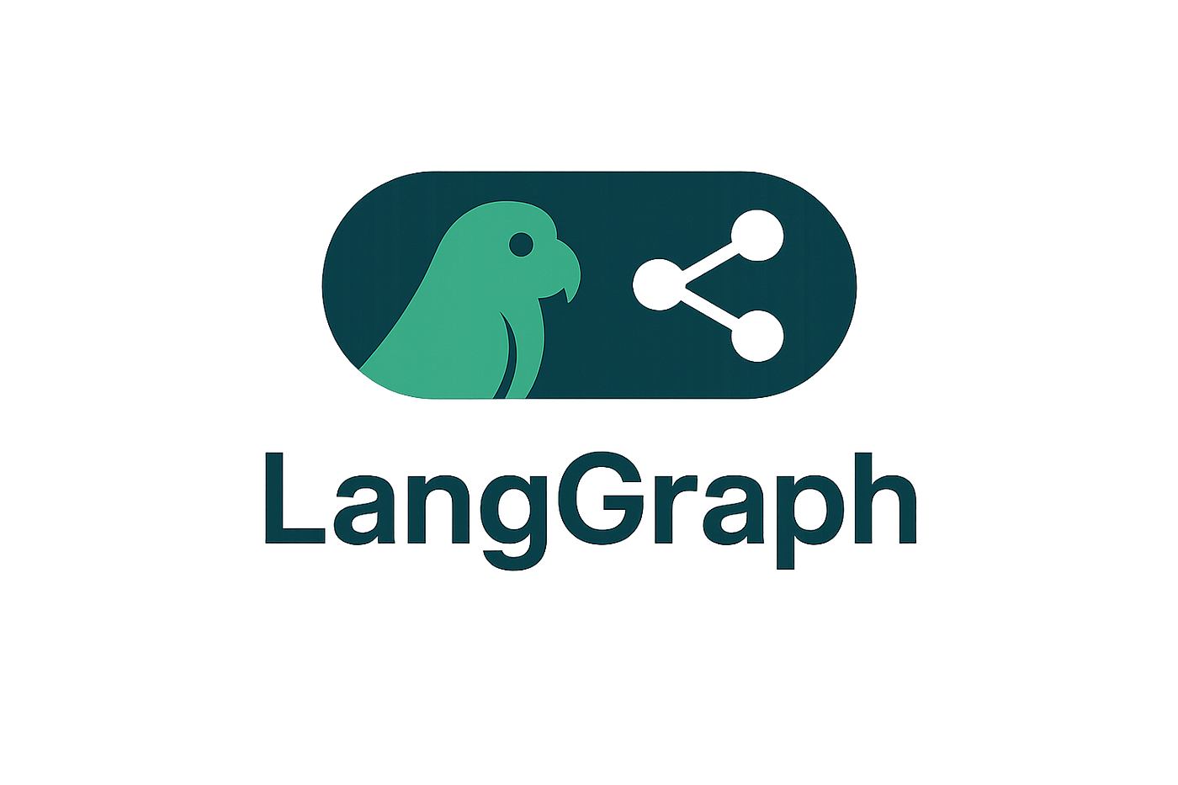
What is LangGraph?
Gain control with LangGraph to design agents that reliably handle complex tasks
Trusted by companies shaping the future of agents, including
Klarna
Replit
Elastic, more.
LangGraph is a low-level orchestration framework and runtime for building, managing, and deploying long-running, stateful agents.

